Slide 1

Final project
Marian Dinca

Slide 2
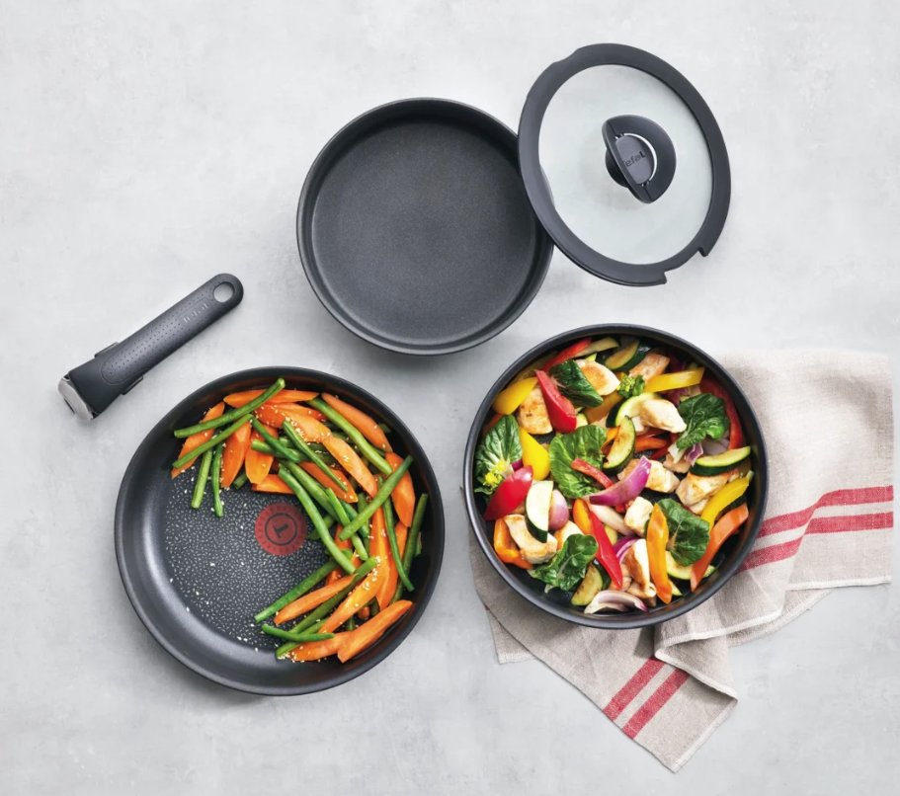

What is shop.tefal.ro
The Tefal e-commerce website is a digital platform where customers can browse and purchase a wide range of Tefal products conveniently online. From innovative kitchen appliances like cookware, kitchenware, and small domestic appliances to household essentials, the website offers a diverse selection of high-quality items designed to enhance cooking experiences and simplify everyday tasks. With user-friendly navigation, detailed product descriptions, and secure payment options, the Tefal e-commerce site provides a seamless shopping experience for those seeking reliable kitchen solutions.
Marian Dinca

Slide 3

Approach
shop.tefal.ro
Account creation
Cart
Reviews
Favorites
Search
Filters
Product comparison
Happy Flow
Marian Dinca

Slide 4

Tools
Test link – For Test Case creation & execution
Mantis – For Bug tracking and reporting
Excel – For Test Data collection
Xmind – For Mind Mapping
Exploratory Testing Chrome Extension
Word – For Test Report creation
Marian Dinca

Slide 5
Testing Types
Positive Testing
Negative Testing
Smoke Testing
Compatibility Testing
Exploratory Testing
Ad-hoc Testing
End-to-end Testing
Performance Testing
To ensure that the app does what it is supposed to do.
To ensure that the app does not fail when an unexpected input is given.
To ensure that the most critical functions work.
To ensure that the app behaves similarly on different browsers.
To cover a wider range of functions.
To learn what are the main app functions.
To ensure that the entire flow works properly.
To ensure that the app loads in a timely manner.
Marian Dinca

Slide 6
Test Case Overview
Functionality | Tests Created
Account Management | 6
Cart Management | 3
Product Comparison | 2
Favorite Products | 3
Search | 2
Compatibility | 4
Product Review | 1
Product filtering | 1
Buy From Partners | 2
Performance | 1
Total | 25
Marian Dinca

Slide 7

Bug Overview
Functionality | Defects Found | Severity
Account Management | 2 | Normal
Delivery | 1 | Normal
Cart | 1 | Normal
Total/Average | 4 | Normal
Marian Dinca

Slide 8
Test Case Results
Functionality | Passed | Failed
Account Management | 4 | 2
Cart Management | 2 | 1
Product Comparison | 2
Favorite Products | 3
Search | 2
Compatibility | 4
Product Review | 1
Product filtering | 1
Buy From Partners | 2
Performance | 1
Total | 22 | 3
Marian Dinca

Slide 9


Conclusions
In conclusion, the store has performed well in rigorous testing across different browsers.
Although three bugs were initially found, further investigation revealed no substantiated issues.
Our testing methods covered various aspects, ensuring stability and functionality.
Moving forward, we'll address one identified improvement. With meticulous testing, the store is ready for a successful release, meeting user needs across platforms.
Marian Dinca

Slide 10

Lessons Learnt
The testing process has yielded several valuable lessons:
Comprehensive Browser Testing: Testing across multiple browsers is essential to ensure compatibility. This highlights the need for thorough validation across different user environments.
Diverse Testing Methodologies: Employing a diverse range of testing methodologies, including positive, negative, and performance testing, is effective in uncovering potential issues and ensuring system resilience.
Continuous Improvement: Identifying areas for improvement underscores the importance of ongoing refinement to enhance the user experience. This emphasizes the need for continual assessment and enhancement of the system.
By adhering to these insights, future testing efforts can be better structured, ensuring the quality and reliability of software products.
Marian Dinca

